Slide 1
SOC ANALYSIS CAPSTONE PROJECT - Simulating Attacks and Writing a SOC Report for SoluTech
Steps to take to achieve our objective:
➢ Conduct controlled attacks using common tools.
➢ Interpret alerts from a SIEM (Wazuh).
➢ Identify malicious activity from log data.
➢ Document incidents using SOC reporting standards.
➢ Implement basic incident response steps.

Slide 2
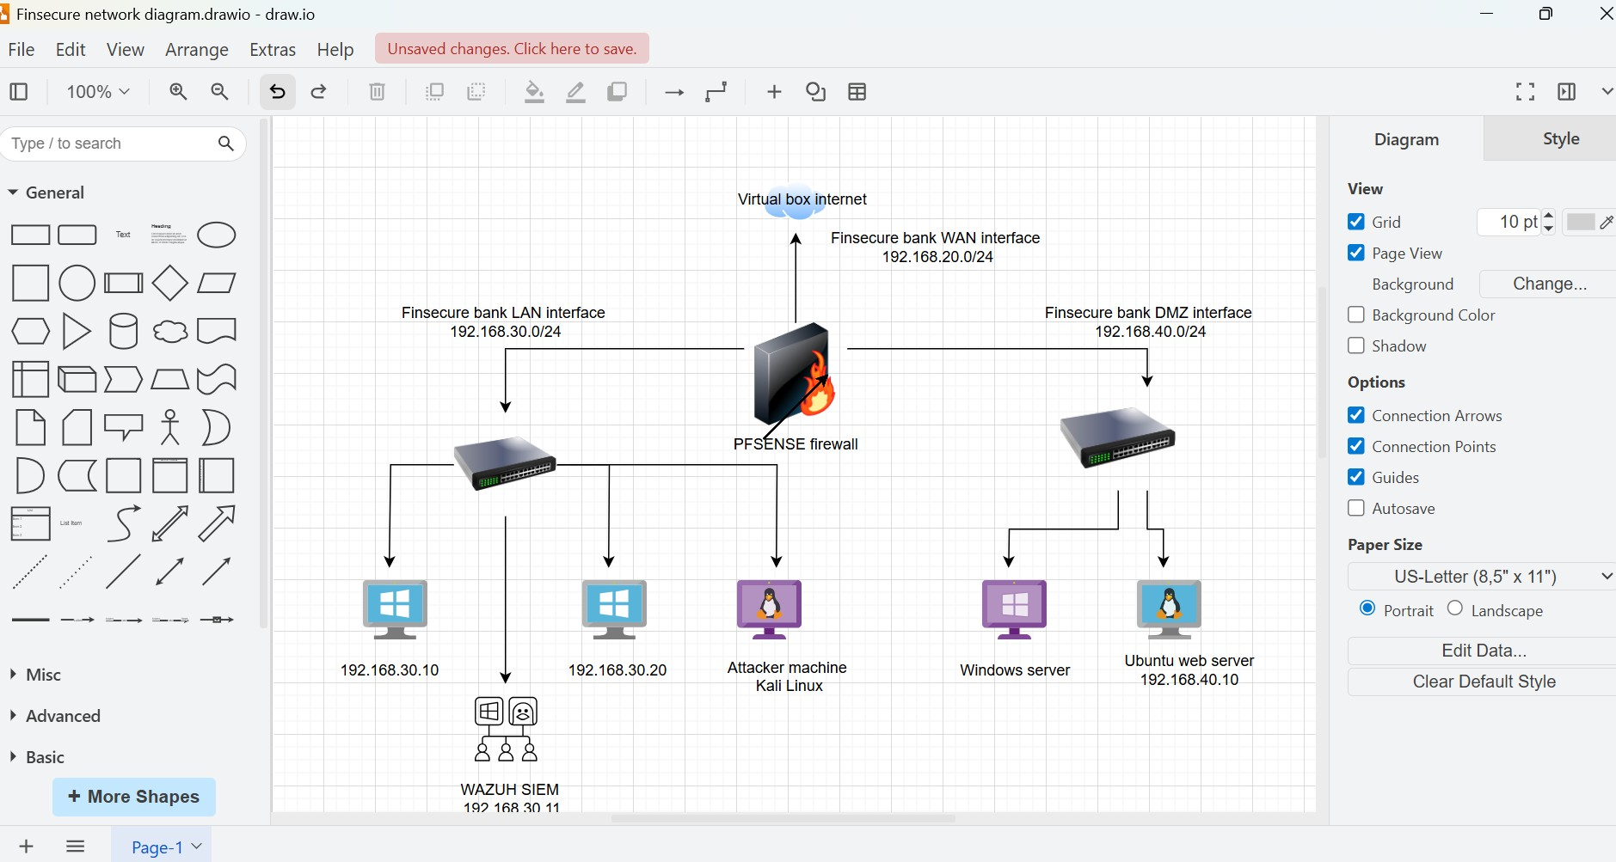
SOC ANALYSIS CAPSTONE PROJECT – Proposed network diagram showing endpoints on network

Slide 3
SOC ANALYSIS CAPSTONE PROJECT – Proposed network diagram showing endpoints on network
Ubuntu –my endpoint device on the DMZ
Wazuh – SIEM tool
Kali – endpoint attacker machine
Windows10 - endpoint device

Slide 4
Assigned IP addresses
WAN 192.168.20.4/24
LAN 192.168.30.1/24
DMZ 192.168.40.1/24

Slide 5
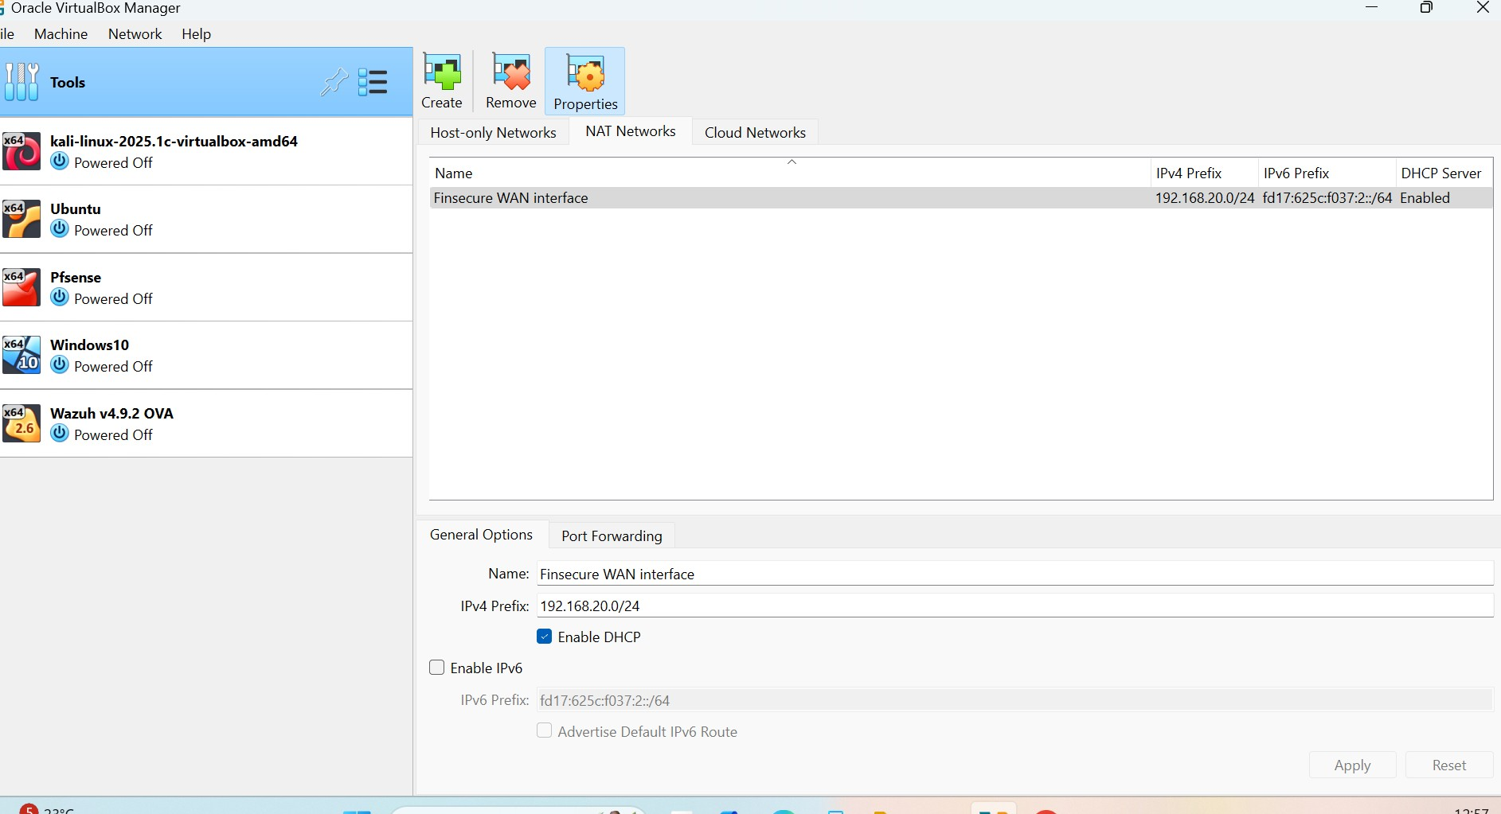
Virtualbox configuration on IPV4 WAN interface

Slide 6
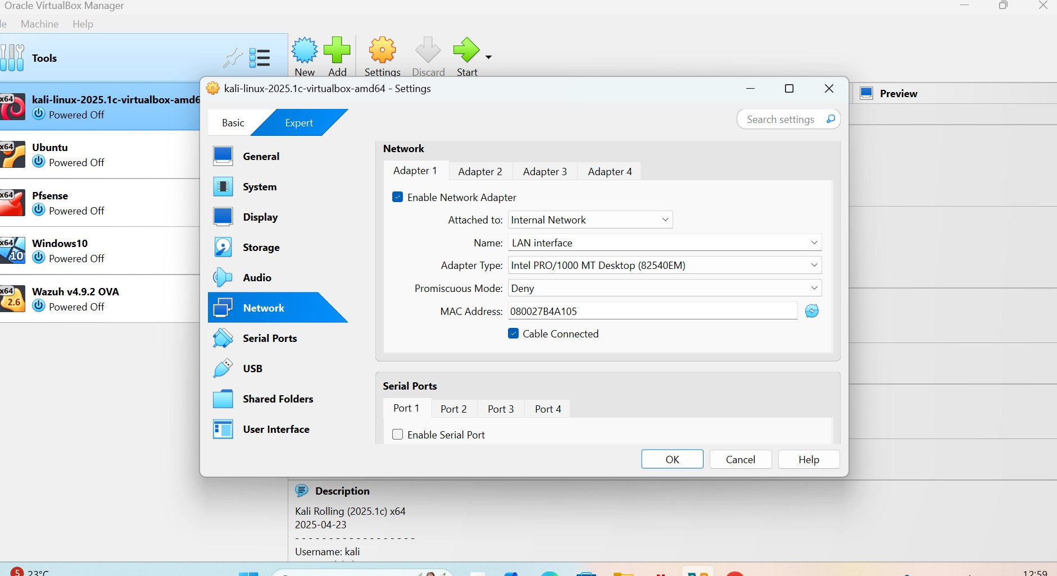
Kali Likux configuration on the Adapter 1 LAN interface

Slide 7
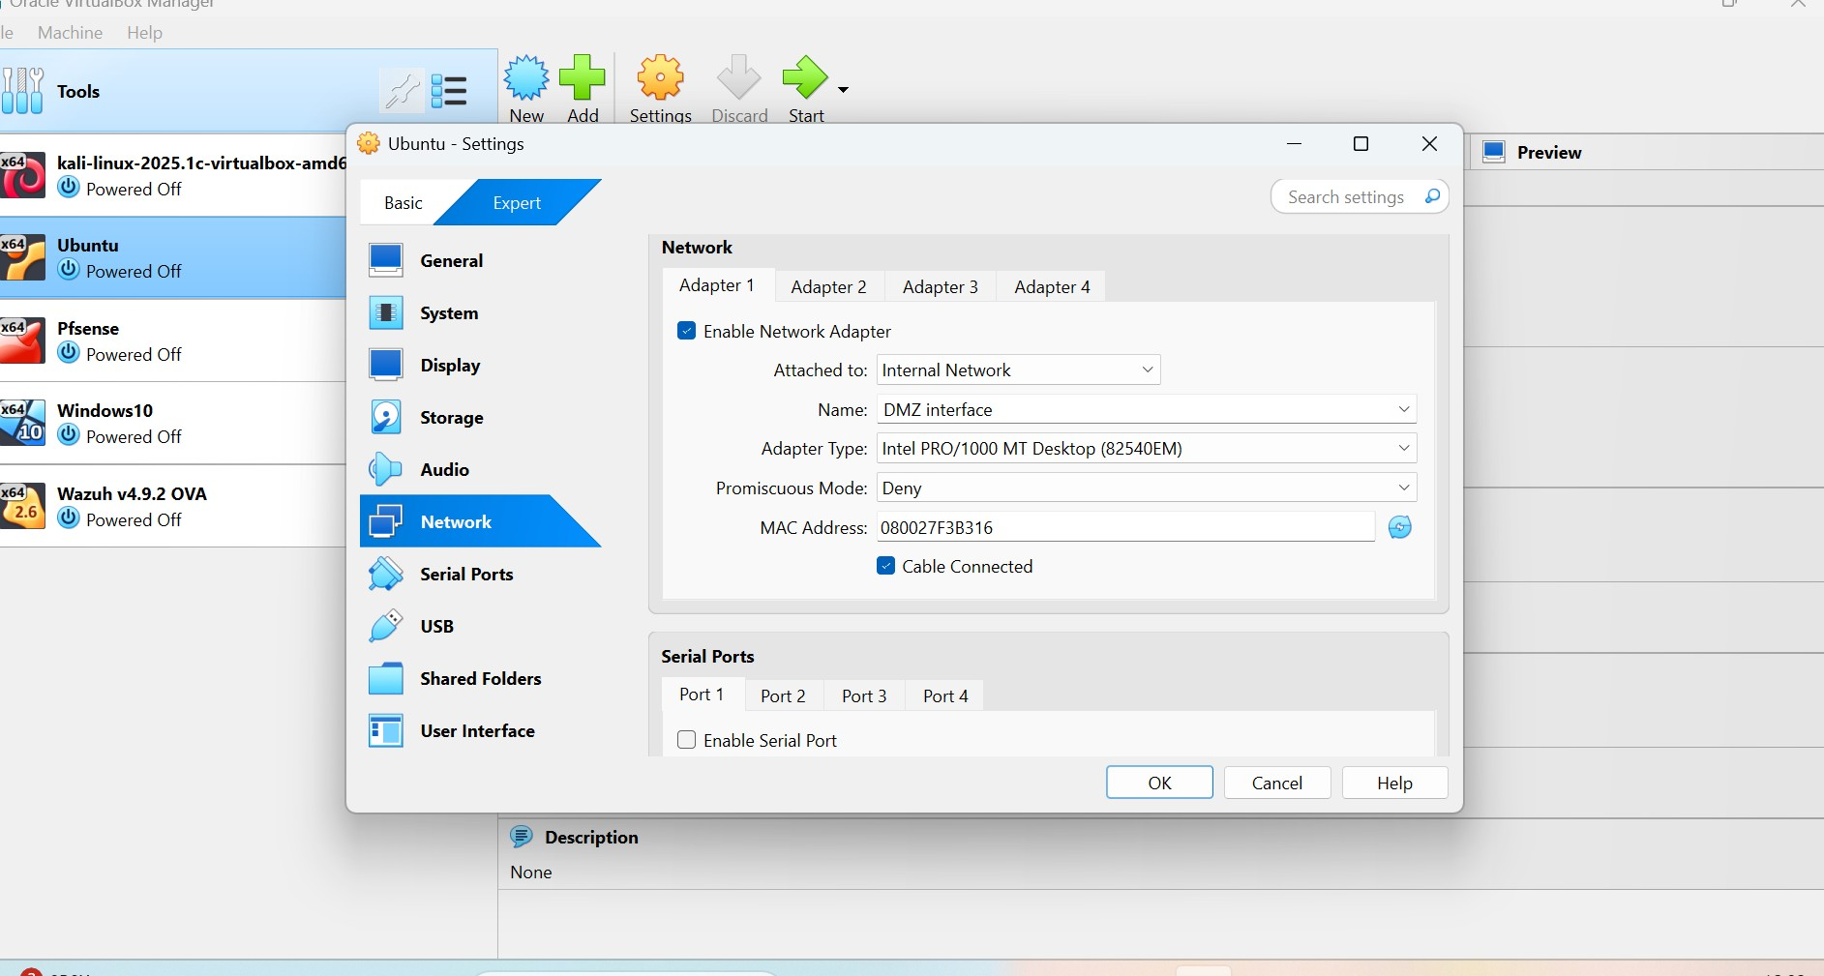
UBUNTU configuration on the internal network DMZ interface

Slide 8
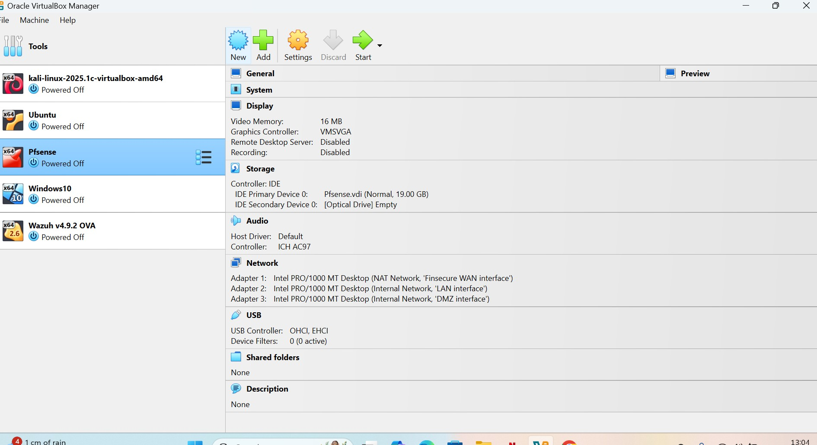
PFSENSE SIEM configuration on Adapters 1, 2 and 3

Slide 9
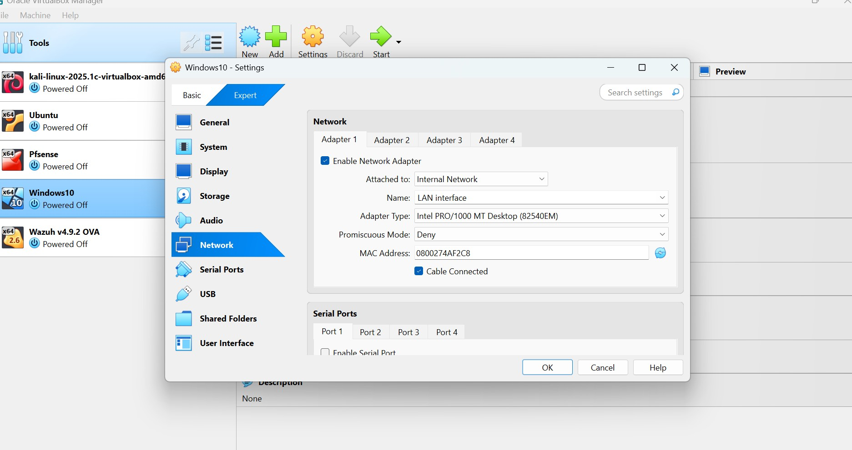
Windows10 configuration on the internal network LAN interface

Slide 10
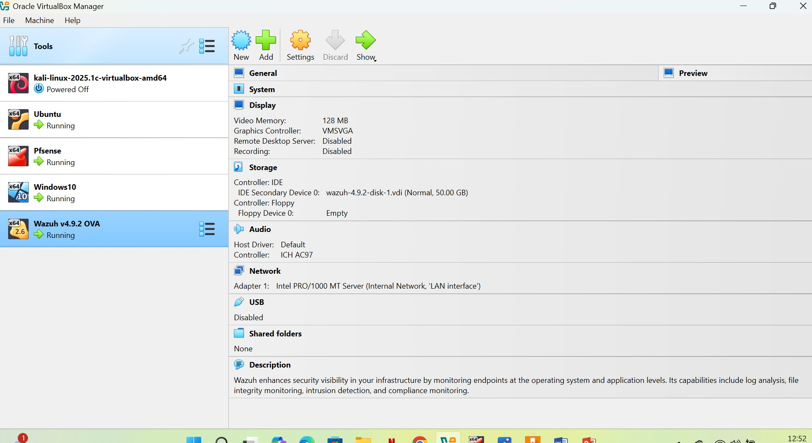
WAZUH SIEM tool configuration on virtual box

Slide 11
Agent installation on windows
Go to windows
Type powershell on windows
Run as administrator, click yes
Go to wazuh GUI
Click on deploy new agent
Enter server address: 192.168.30.12
Agent name: windows10
Default
Copy and paste 1st and 2nd command on powershell.

Slide 12
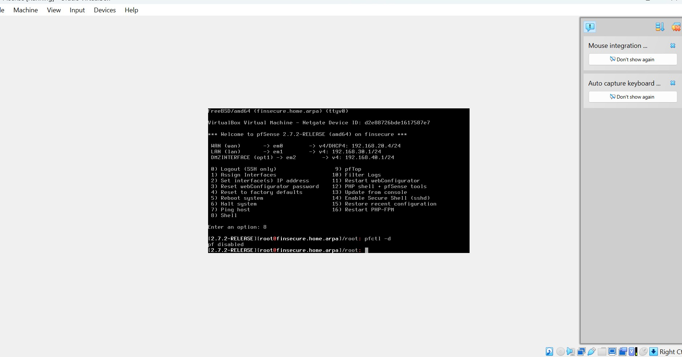
PFSENSE CLI showing connection to ip addresses for WAN, LAN and DMZ

Slide 13
Codes required to activate pfsense
Enter option 8
Enter pfctl -d

Slide 14
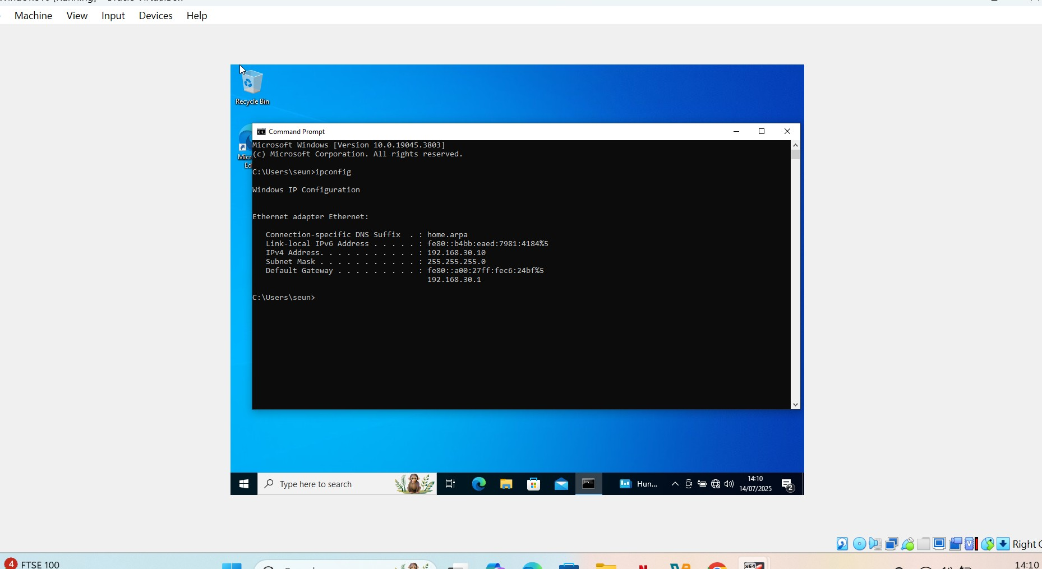
Windows10 showing connection to LAN

Slide 15
Commands used to activate wazuh
Sudo –I
systemctl
(root@wazuh-server) #systemctl start wazuh-manager
(root@wazuh-server) #systemctl start wazuh-dashboard
(root@wazuh-server) #systemctl start wazuh-indexer
(root@wazuh-server) #systemctl status wazuh-dashboard
Ip a s

Slide 16
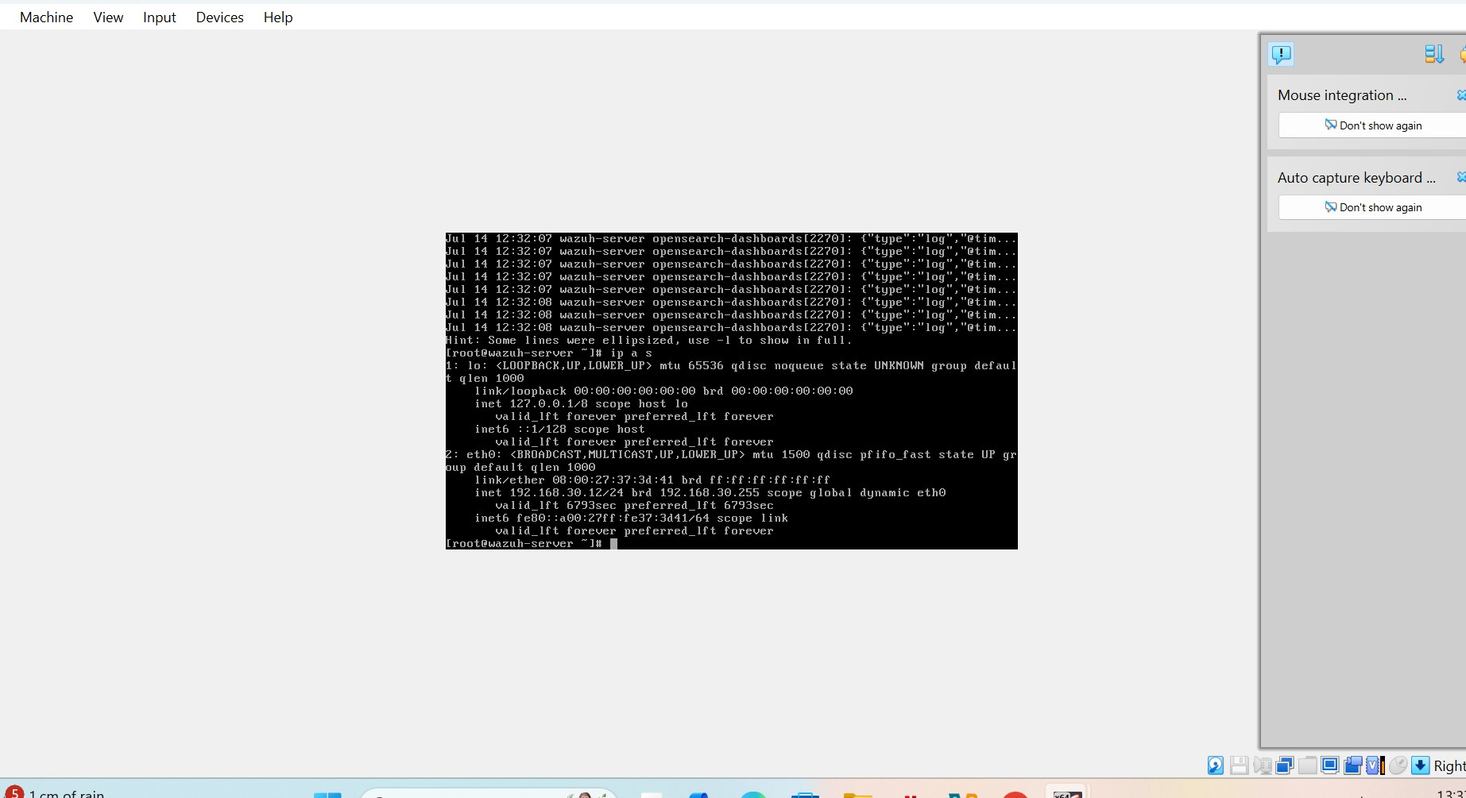
Wazuh siem before activation

Slide 17
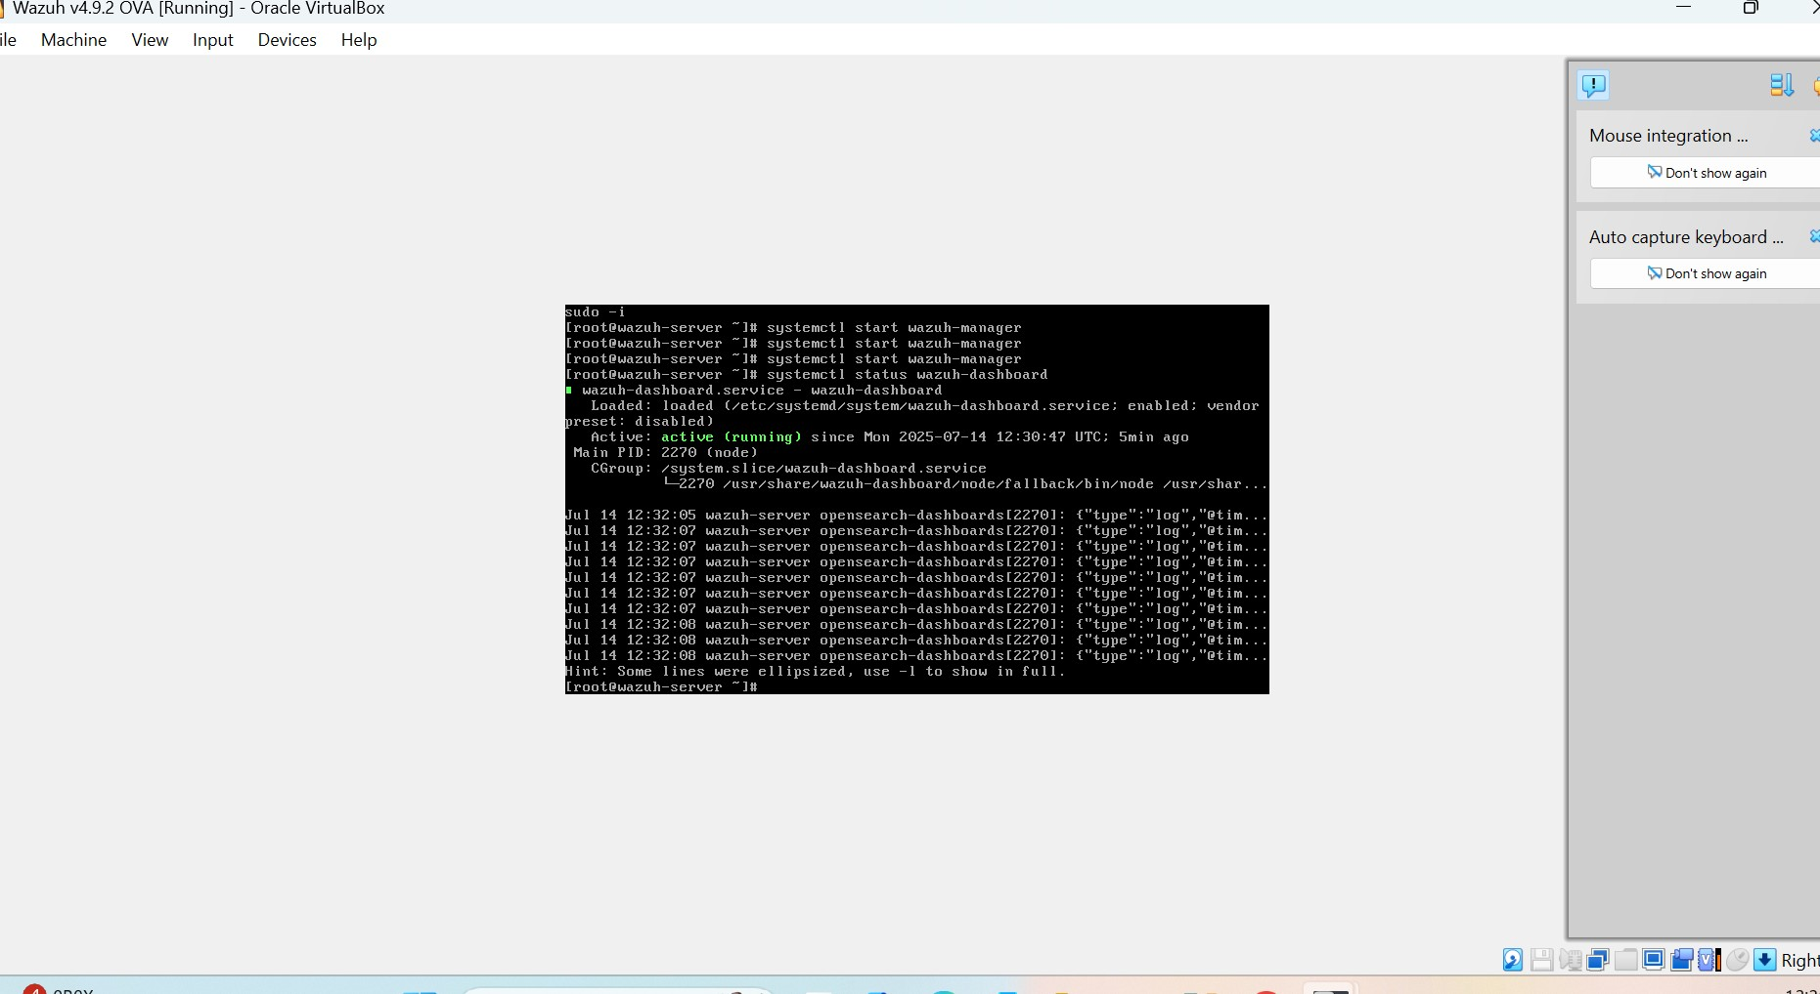
Wazuh showing it is now active

Slide 18
To access endpoints from widows
Pfsense – 192.168.30.1
Wazuh – 192.168.30.12
Ubuntu-192.168.40.10
Windows-192.168.30.10

Slide 19
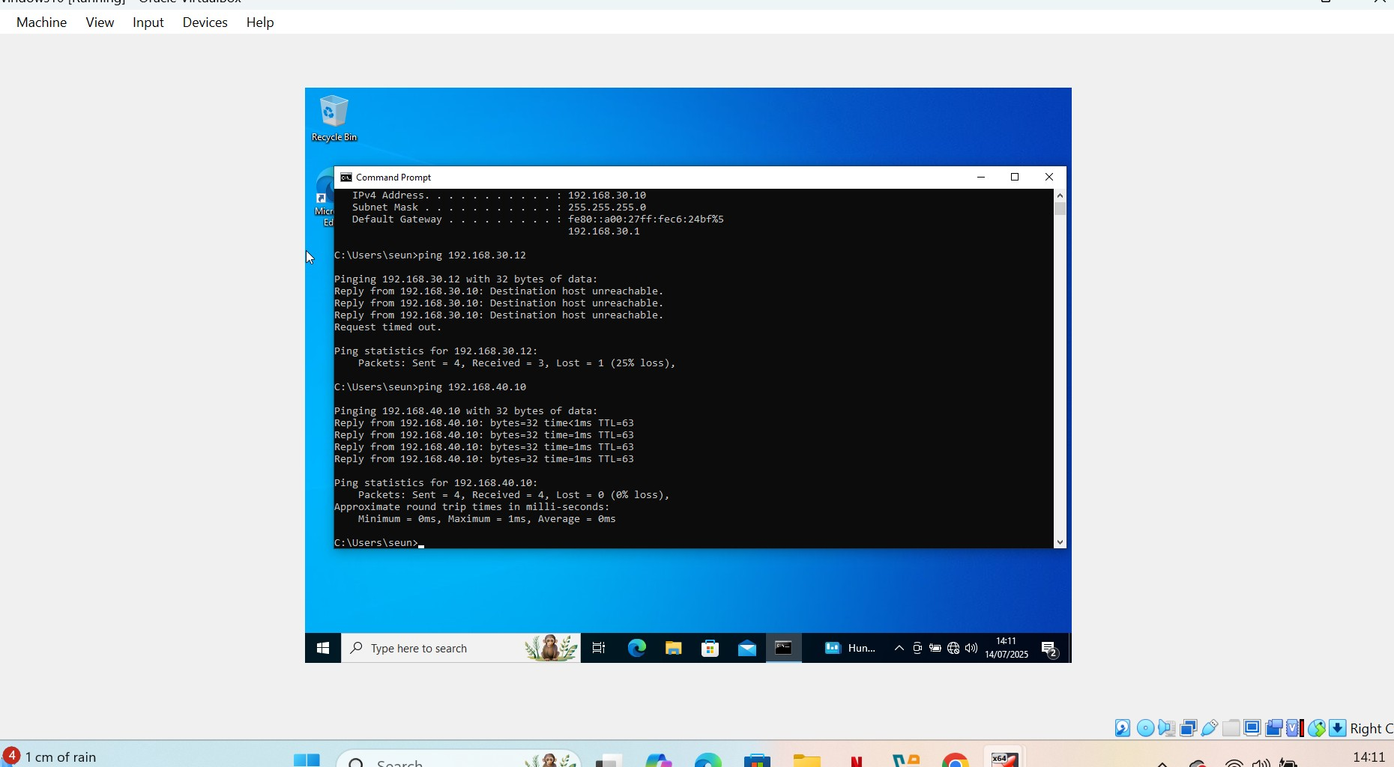
Windows successfully pinging Wazuh siem

Slide 20
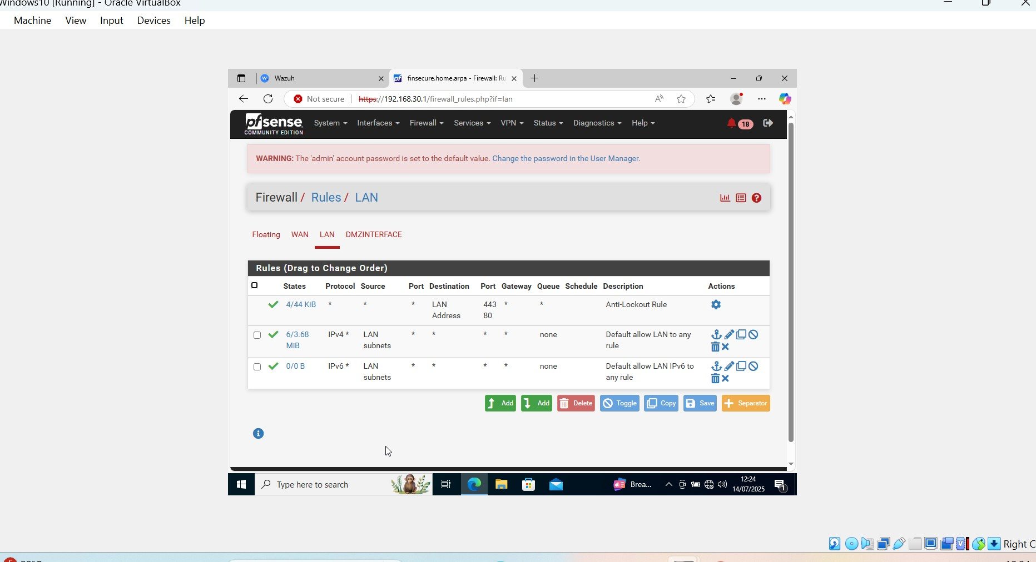
Windows10 successfully connecting to pfsense firewall

Slide 21
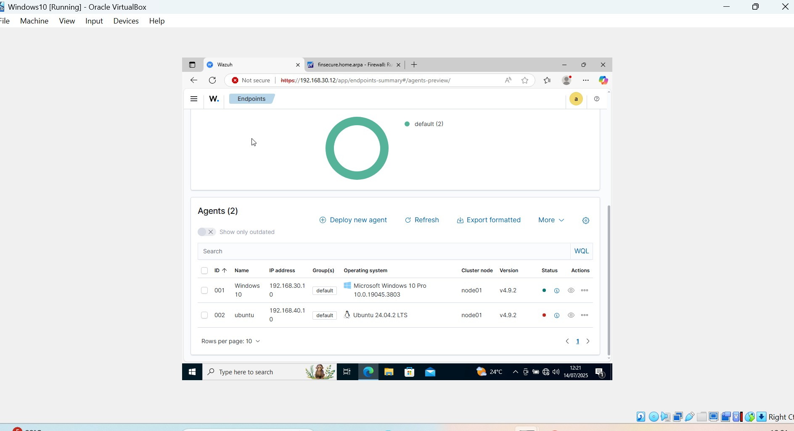
Windows10 successfully connecting to wazuh siem after deploying agent

Slide 22
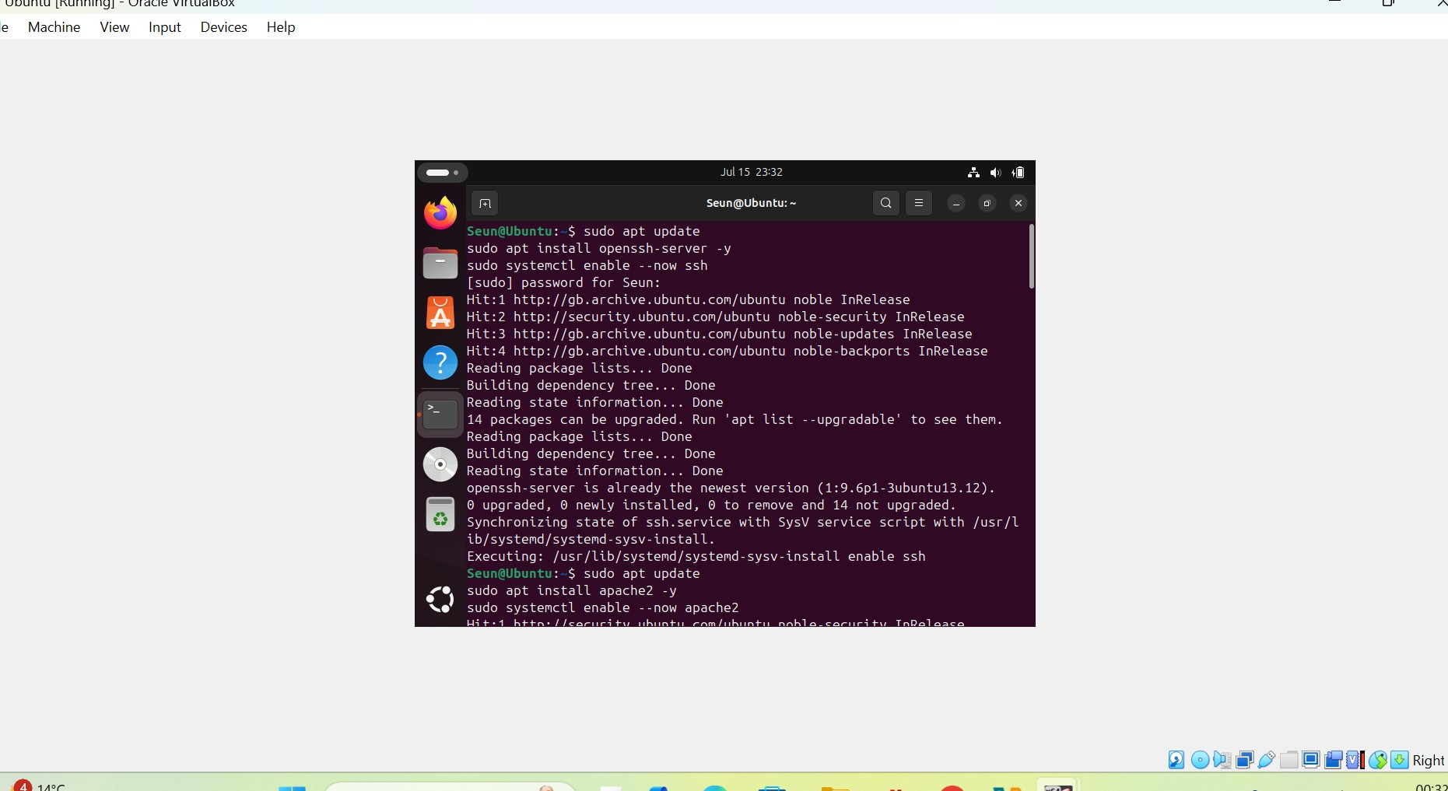
Powering up of Ubuntu endpoint device on DMZ

Slide 23
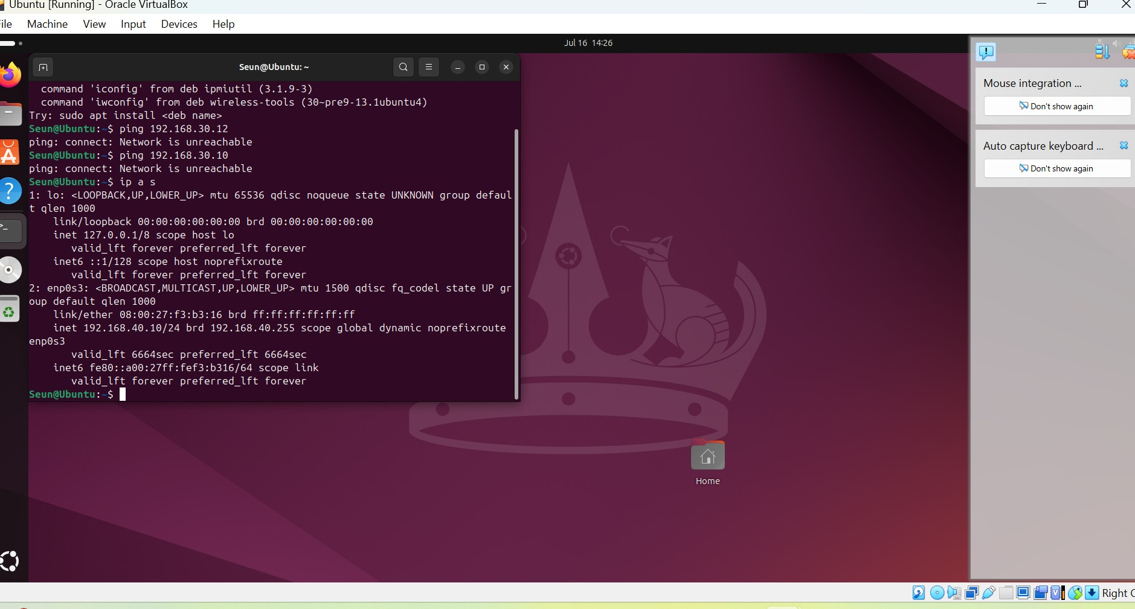
Scanning for ip address on ubuntu

Slide 24
Activating Ubuntu endpoint agent
Ubuntu activation for activation
sudo systemctl start wazuh-agent

Slide 25
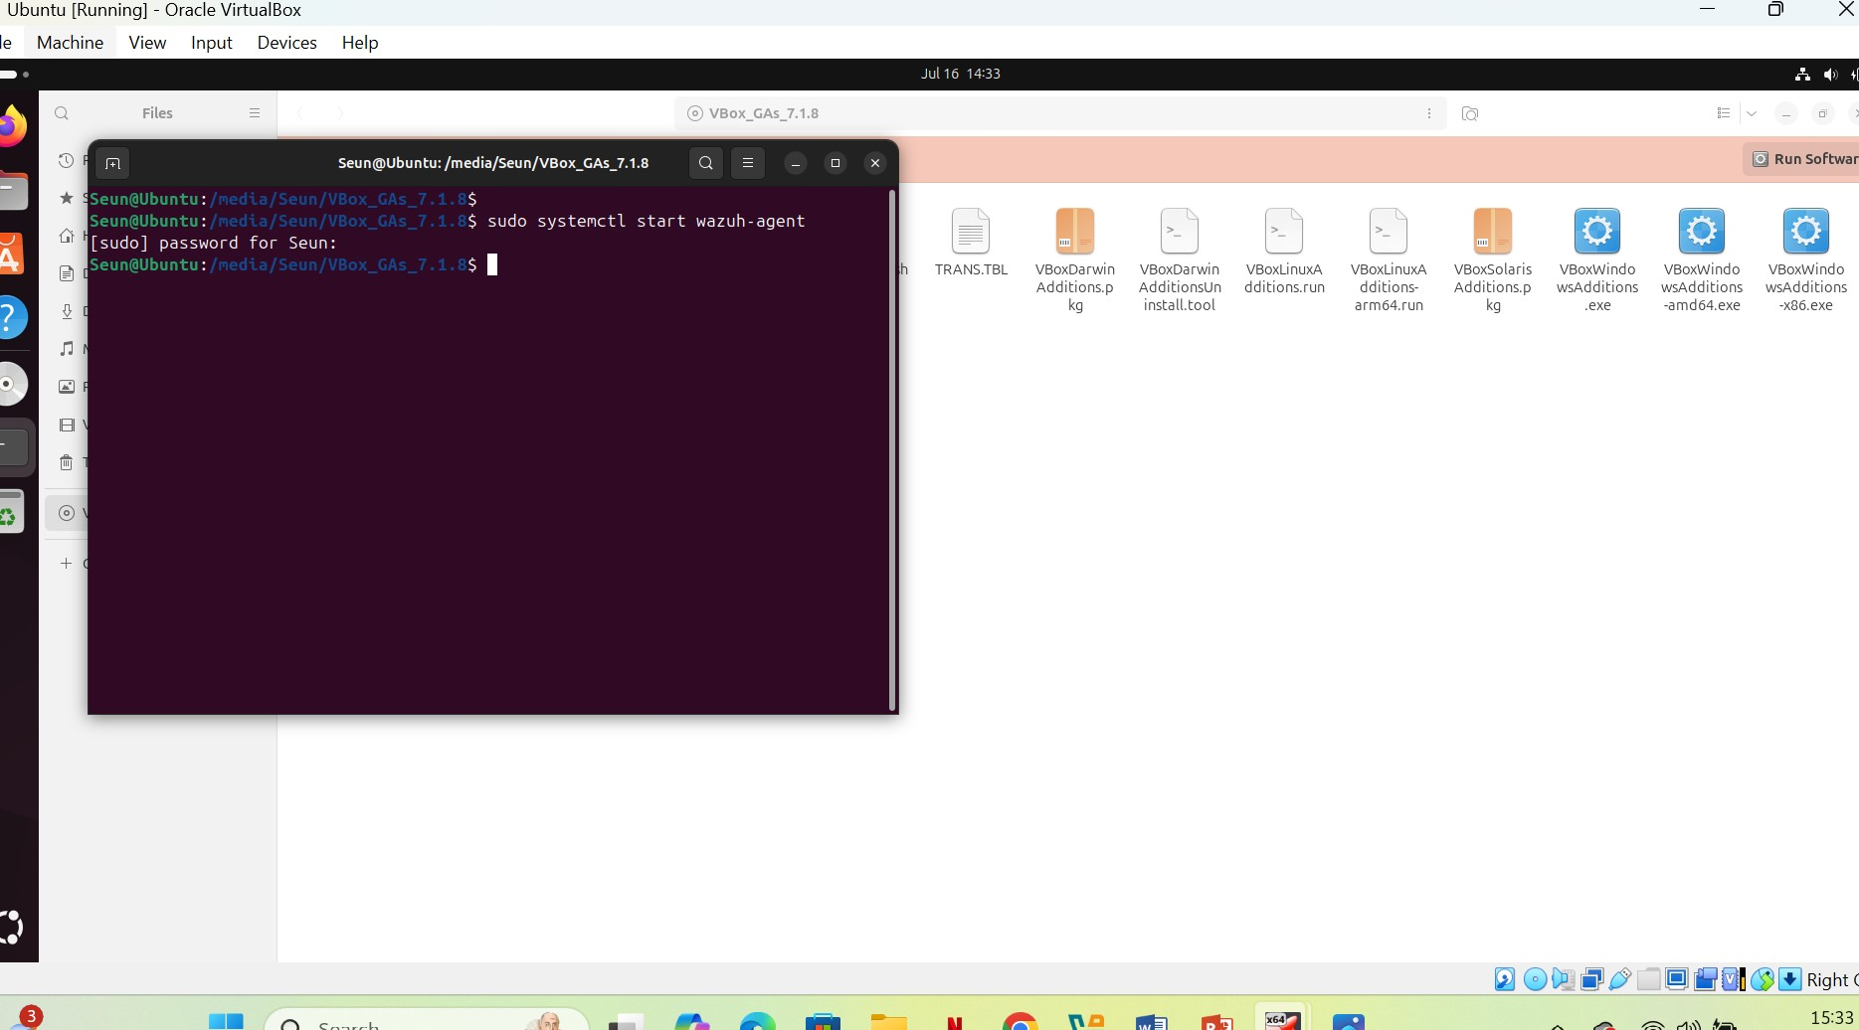
Activating Ubuntu endpoint agent

Slide 26
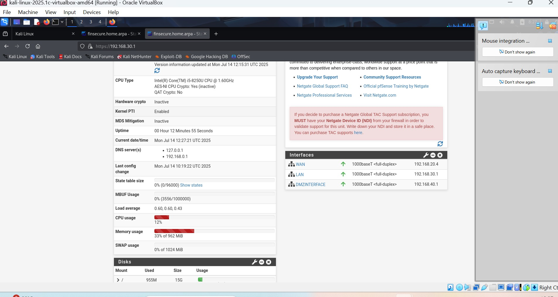
Kali connecting to pfsense dashboard

Slide 27
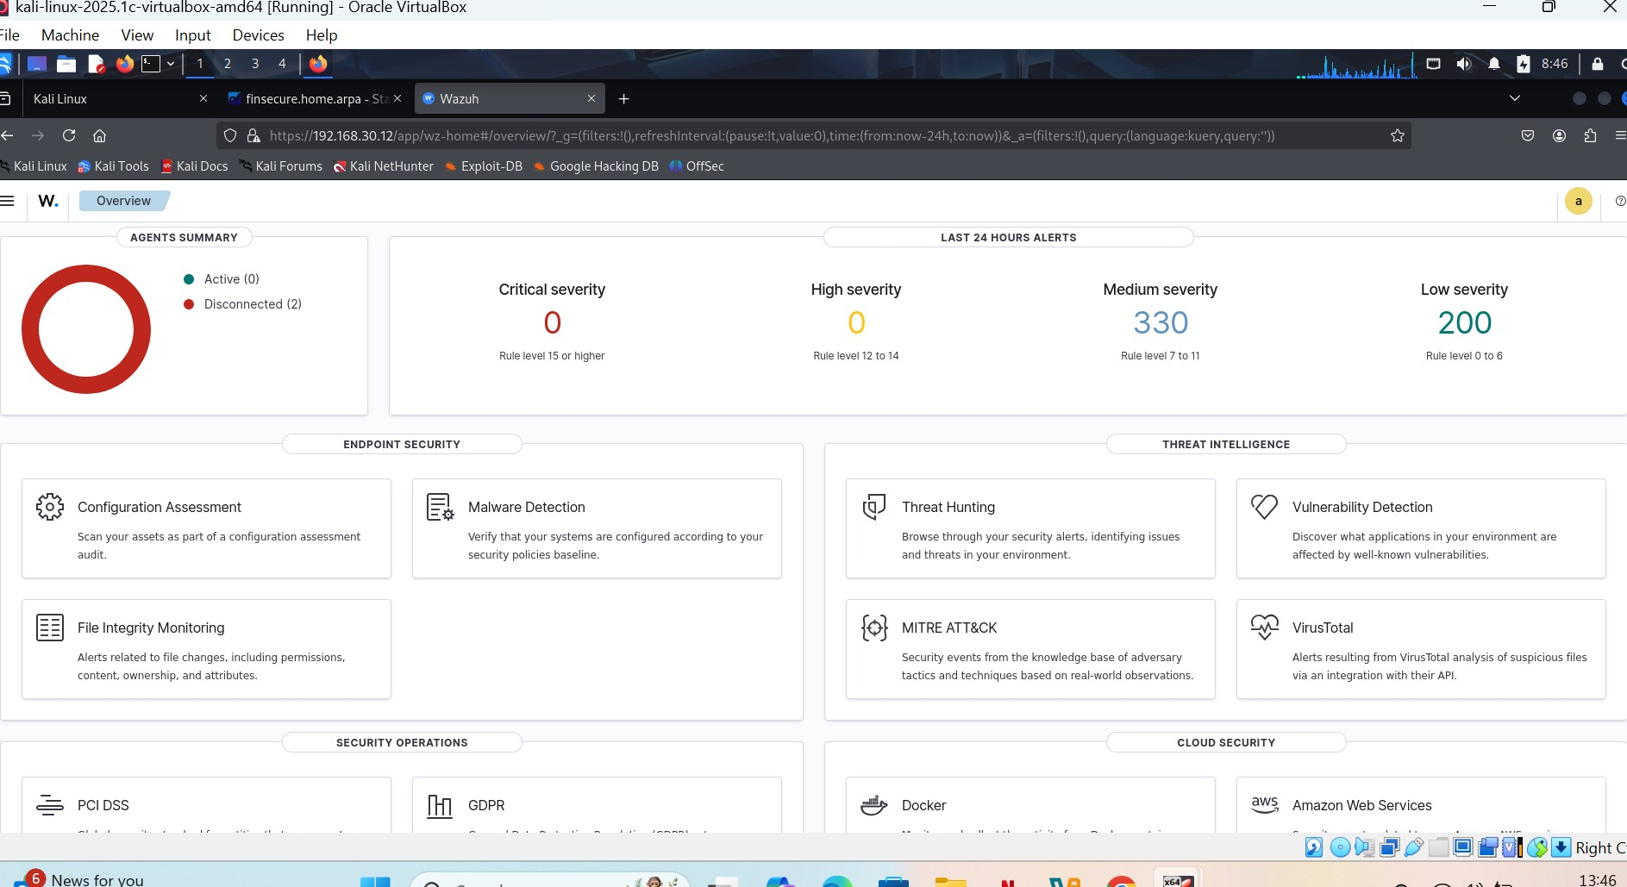
Kali connecting to wazuh dashboard

Slide 28
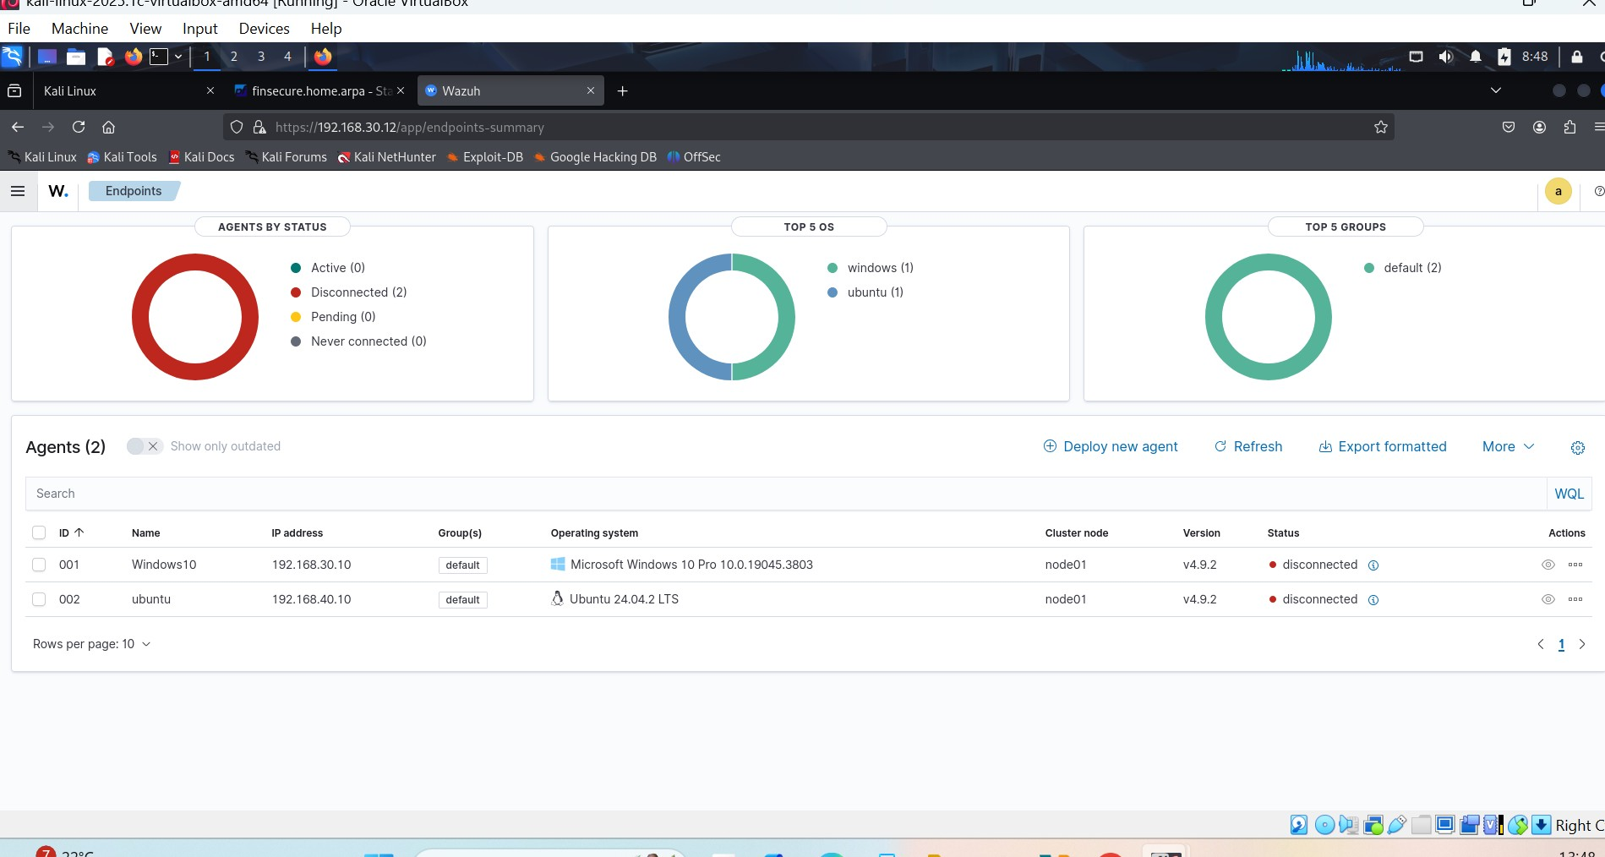
Kali connecting to wazuh dashboard

Slide 29
Using nmap to scan for open ports on windows
nmap 192.168.30.10
nmap 192.168.30.0/24
Nmap 192.168.40.0

Slide 30
Using nmap to scan for open ports on ubuntu
Nmap 192.168.40.0/24
To upgrade Ubuntu
Sudo Apt update
Sudo apt upgrade

Slide 31
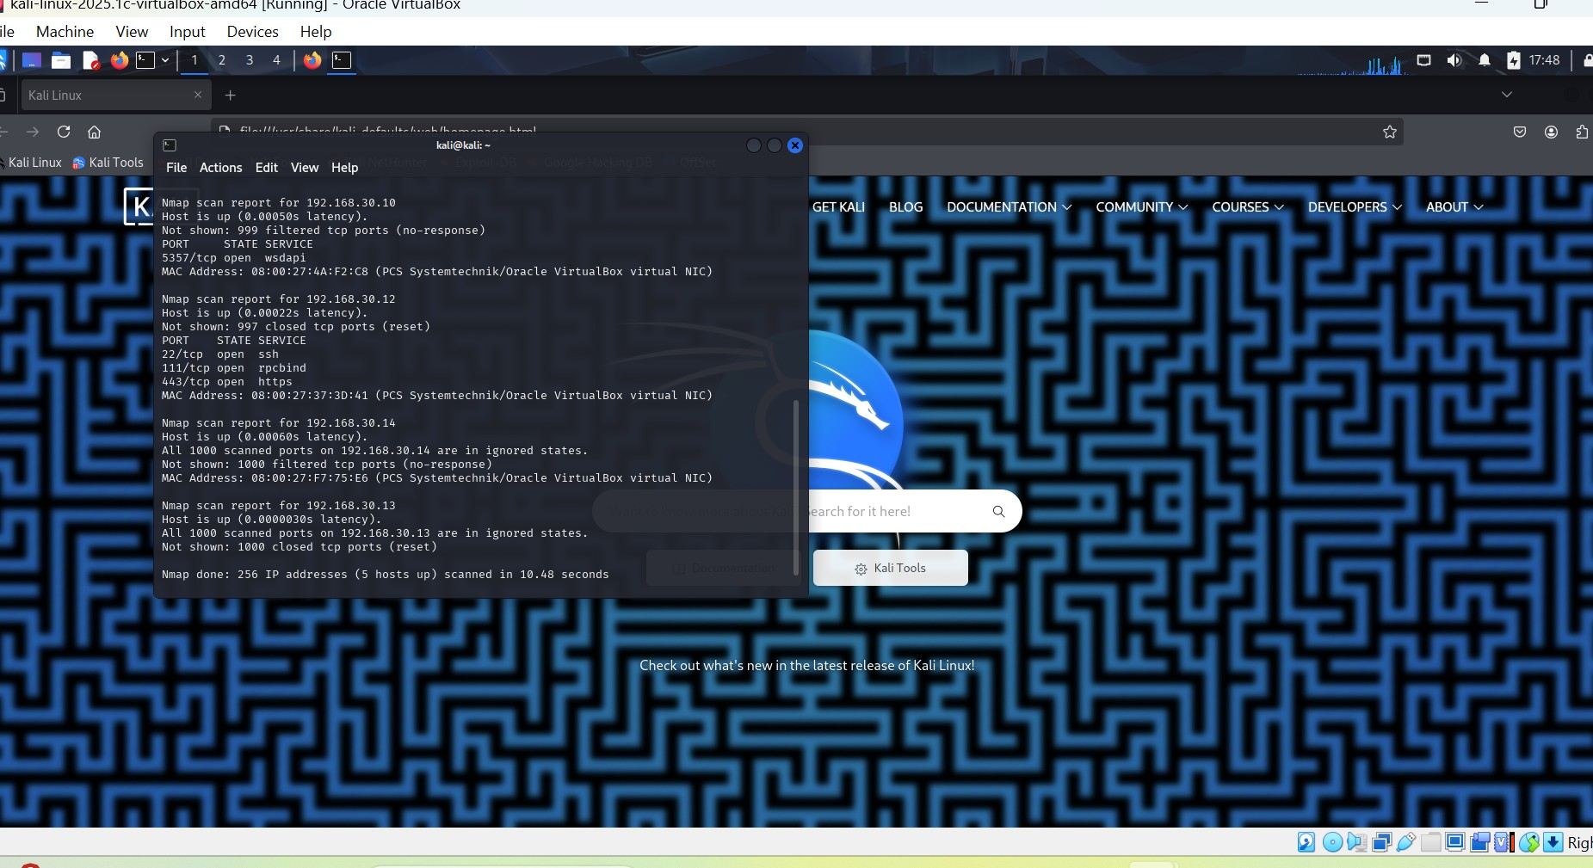
Kali attacker scanning for open ports, no ports found

Slide 32
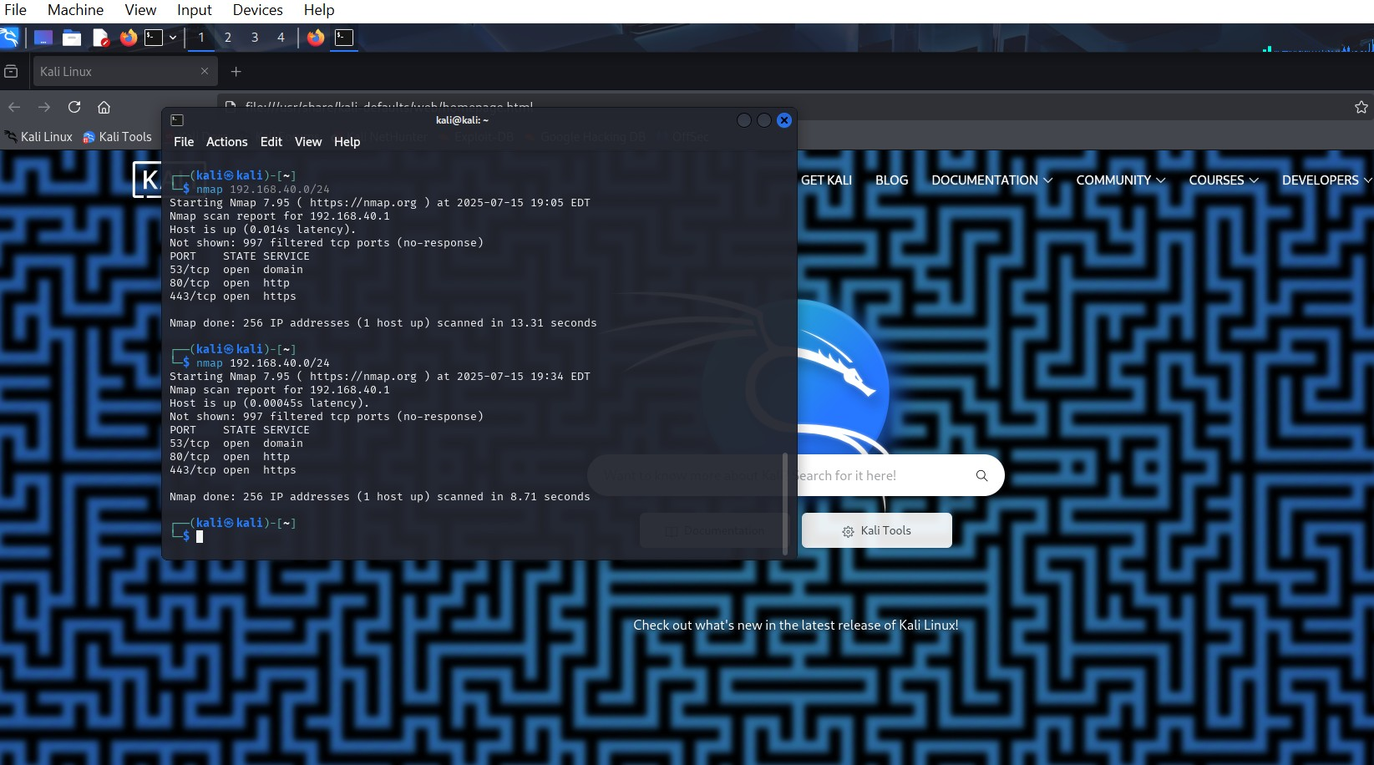
Kali attacker machine scanning for open ports, ports found

Slide 33
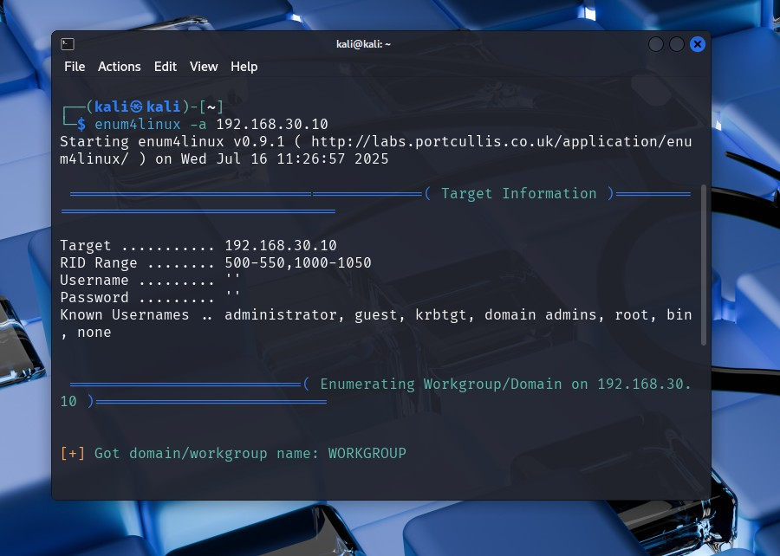
Nmap port scan

Slide 34
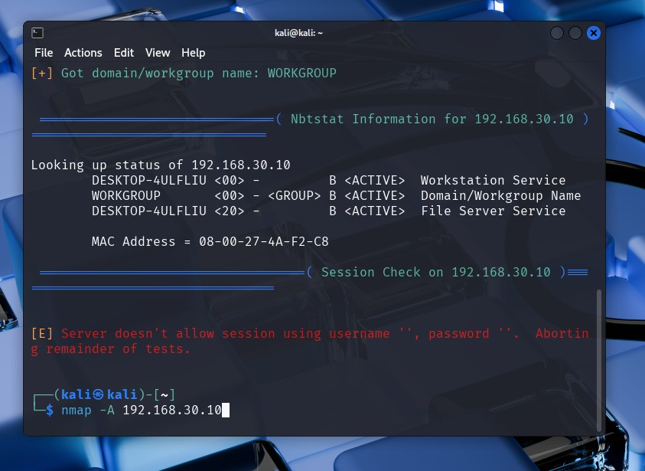
Nmap port scan

Slide 35
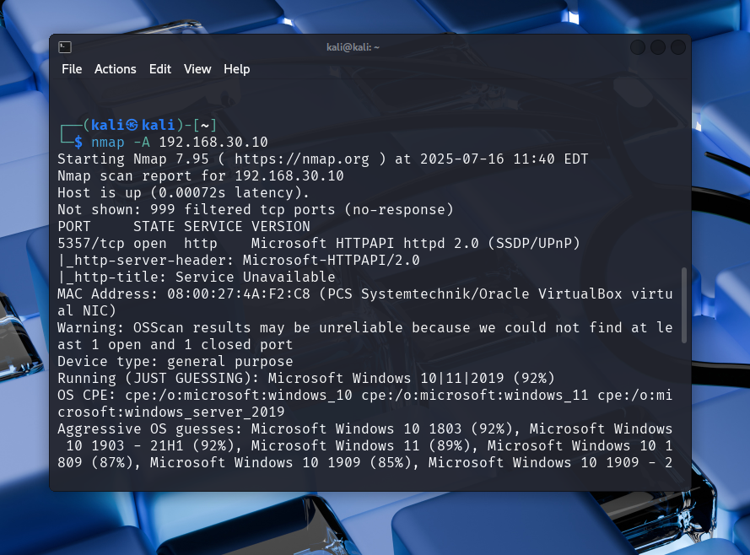
Nmap scan for ports

Slide 36
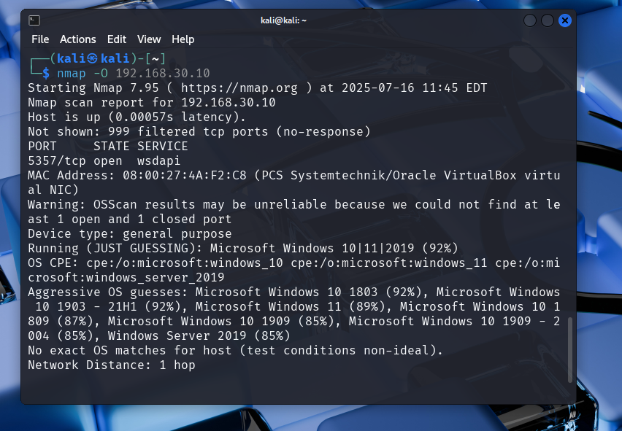
Nmap scan for ports

Slide 37
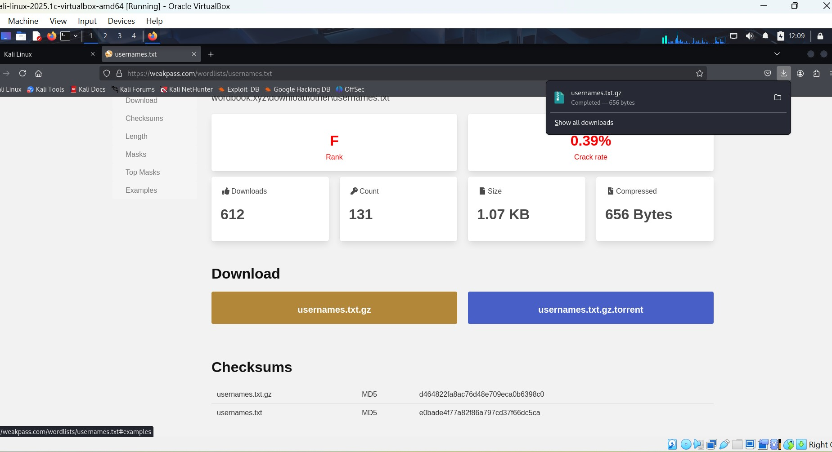
User name download for attack

Slide 38
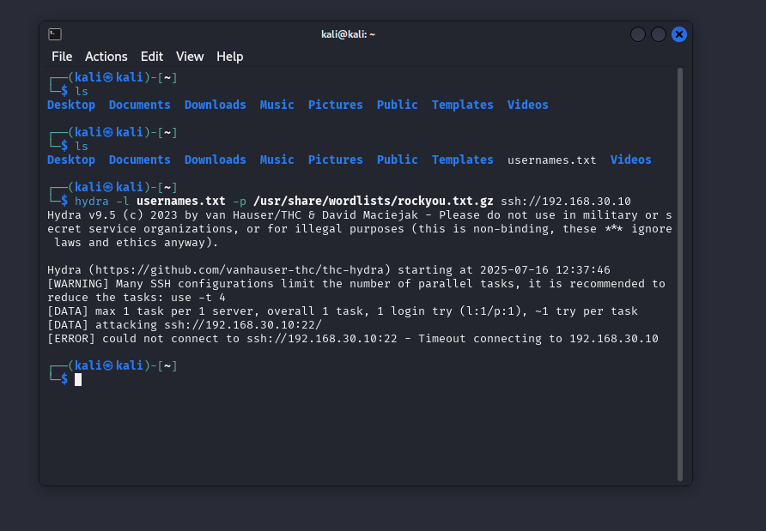
Hydra code used to attempt attack

Slide 39
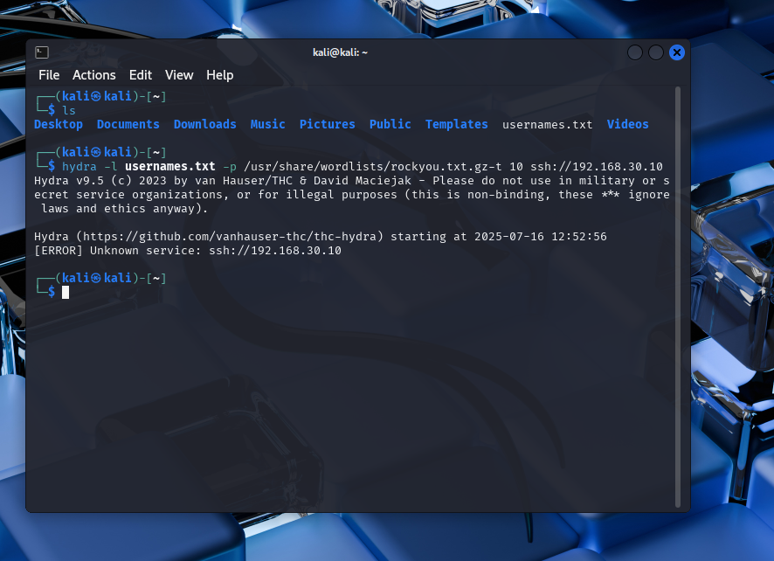
Hydra code used to attempt attack

Slide 40
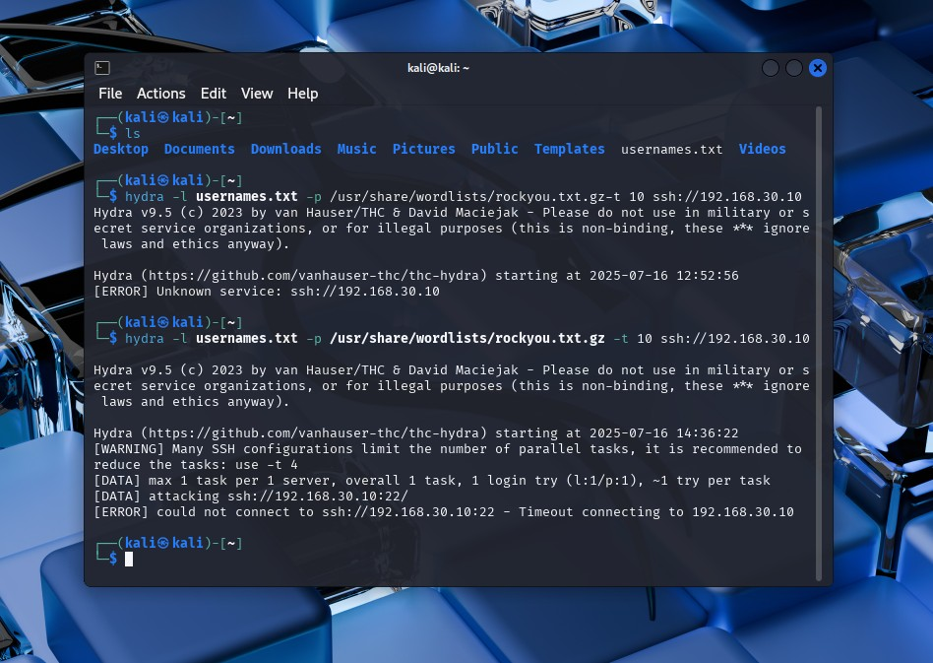
Hydra code used to attempt attack

Slide 41
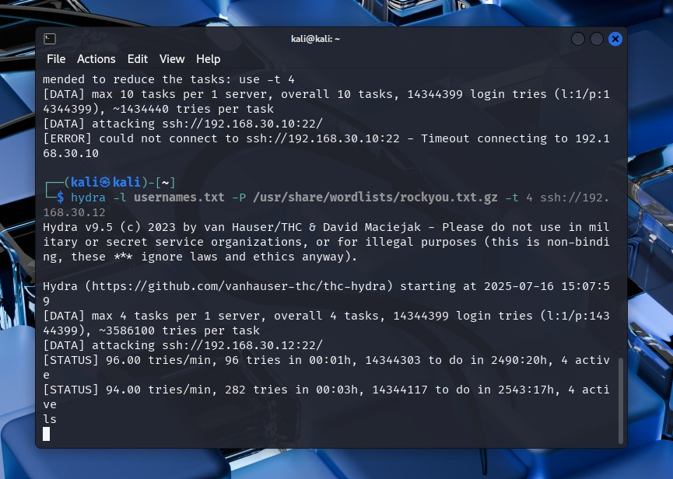
Hydra code used to attempt attack

Slide 42
Hydra code used to attempt attack
Code used for hydra attack by Kali endpoint:
Hydra –l usernames.txt –p /usr/share/wordlists/rockyou.txt.gz –t 10 ssh://192.168.30.10

Slide 43
Self reflection
I attempted to use the Kali endpoint to attack the windows system through a bruteforce attack as shown in slide 40 with the code; Hydra –l usernames.txt –p /usr/share/wordlists/rockyou.txt.gz –t 10 ssh://192.168.30.10, however this is not yet successful.
What was easy and what was challenging
I found the installation stage quite easy, however, some of my major challenge were at the configuration stages and getting the agents to work together with the endpoint devices.
What I learnt about attackers
It is possible for an attack to take a while to complete as an attacker can be in an organisations system for weeks to months trying different measures to brute force and gain access into the a database before they are either successful or are discovered by the SIEM

Slide 44
Self reflection
What I learnt about defenders:
Defenders must be up to date of the layest trends in which attackers use to break into systems, they must learn to think like attackers to be capable of preemting the next move of the attackers as well as being versed in the use of various SIEM tools, and intrusion prevention and detection systems to prevent Zero day attacks.
Defence against attacks should be wholistic in nature and is a responsibility of every member of the organisation and must be encouraged through continuous social engineering and phishing awareness programmes through out the organisation.

